Slide 1
Image Classification using CNN
Internal Guide: Ms Neha Jhunjhunwala
Group Members:
Madhan(18311A05L9)
Shashank(18311A05Q0)
Karthik(19315A0519)

Slide 2
Problem Statement
This project aims to create a Deep Learning model that classifies images across ten classes.
Deployment of this model is also taken care of using web frameworks like flask

Slide 3
Abstract
Image classification is the ability to take an image and then successfully classify it into one of a given set of classes
The goal of our work will be to create a model that will be able to identify and classify images accurately.

Slide 4
This project utilizes Convolutional Neural Networks in order to successfully train a model.
The dataset we intend to use is the Cifar 10 dataset.
Deployment is taken care of using Flask and Django

Slide 5
Software Requirements
Operating System: Windows 8 or higher
Tools or Software: Python, Tensorflow, Keras, cifar 10 Dataset, Flask web framework, Django, Jupyter Notebook or any other code editor.

Slide 6
Hardware Requirements
Processor: Intel i3 or higher
RAM: 4GB or higher
Hard Disk: Minimum 512GB

Slide 7
Overview of Steps Involved
1. Coming up with a sufficiently complex model architecture
2. Data normalization to avoid overfitting or underfitting
3. Train and test the model to classify based on the dataset
4. Designing a site using Flask to deploy the model

Slide 8
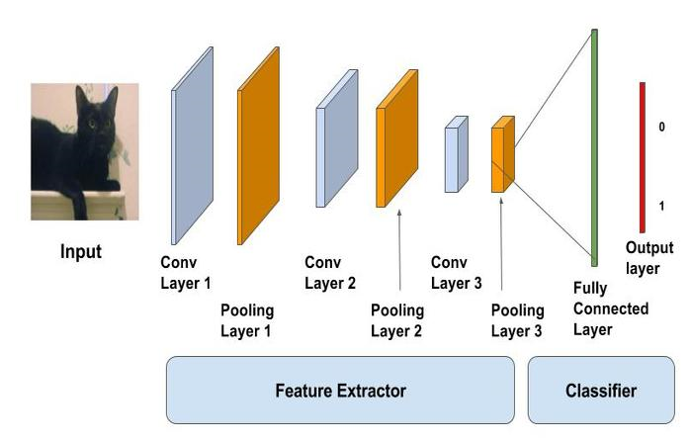
CNN(convolutional neural network)

Slide 9
About Cifar 10 Dataset
The CIFAR-10 dataset (Canadian Institute For Advanced Research) is a collection of images that are commonly used to train machine learning and computer vision algorithms. It is one of the most widely used datasets for machine learning research.

Slide 10
The CIFAR-10 dataset contains 60,000 32x32 color images in 10 different classes. The 10 different classes represent airplanes, cars, birds, cats, deer, dogs, frogs, horses, ships, and trucks. There are 6,000 images of each class.

Slide 11
Thank You

